Slide 1
Financing Climate Justice Part One: OUT OF TIME
Tax Justice Forum
-- Newsletter of the Tax Justice Network
James S. Henry, Esq. Senior Advisor, TJN
Global Justice Fellow Yale University
March 2020
© JSH, TJN 2019, 2020
1

Slide 2
Summary – Out of Time
¶ Global CO2/ GHG reached an 800,000-year peak in 2019
¶ Long awareness of the problem (since at least 1958)…..
¶ Attempts to solve the problem by way of “rational public discourse” (political debate, summits, negotiations, consensus targets, science reports, films, other media..) have failed.
¶ IPCC targets (e.g. “1.5 – 2.0 ⁰ C”) are not only way too low
but unachievable without extreme measures
¶ Many graphic examples of irreversible damage already…
© JSH 2020

Slide 3
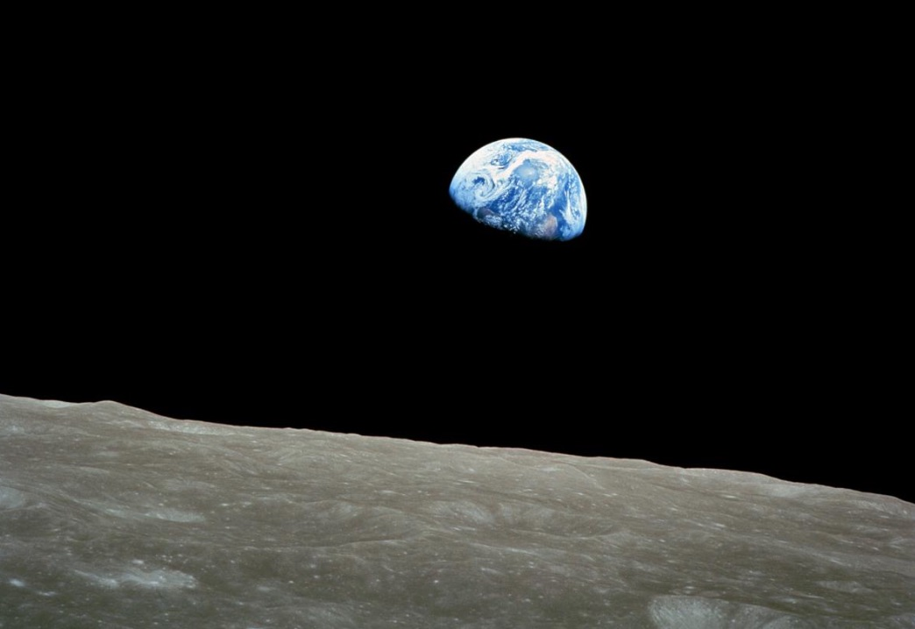
From a distance, all looks well…
3
© JSH 2020

Slide 4
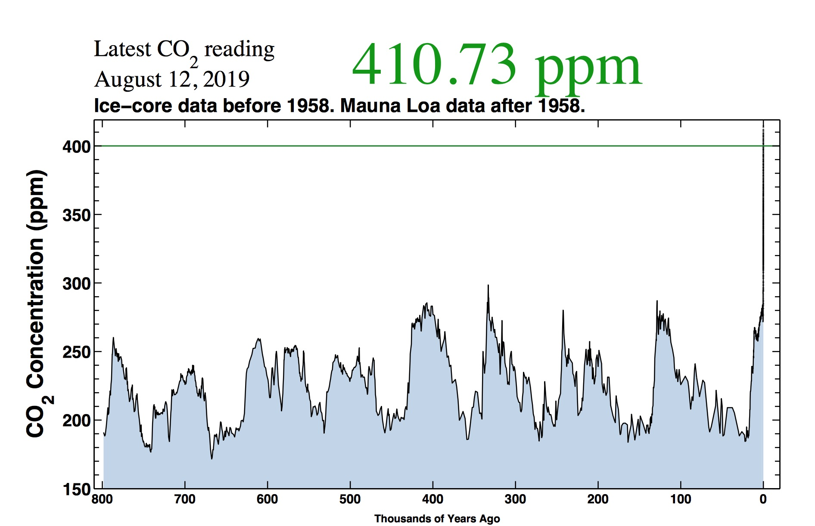
Not….
© JSH 2020
6

Slide 5
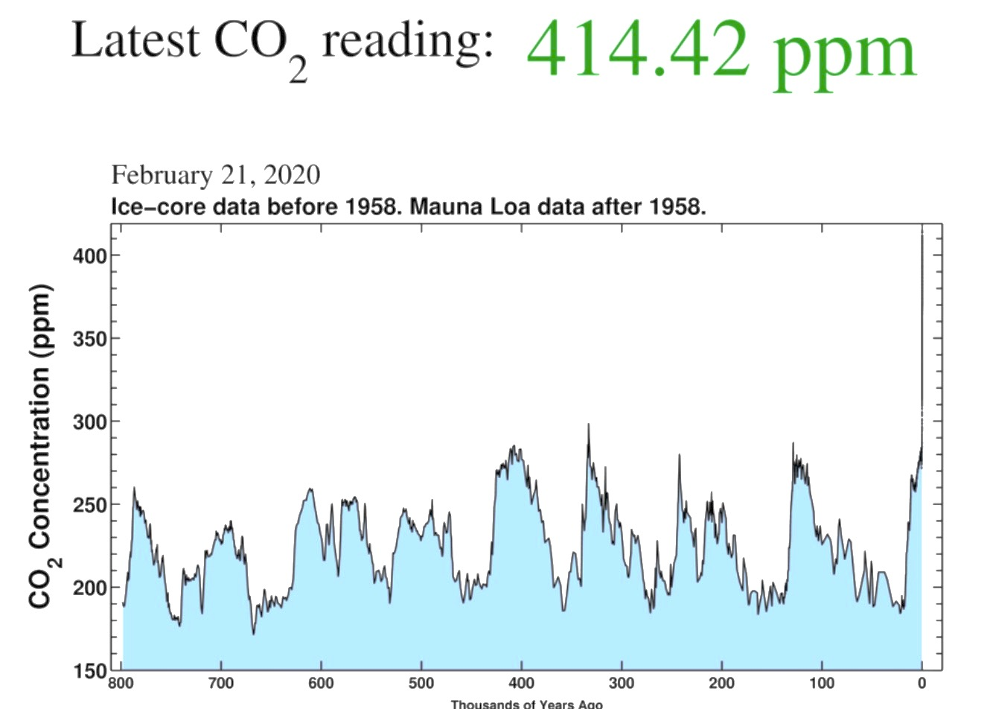
© JSH 2020
6

Slide 6
The Keeling Curve
https://youtu.be/Z43FQCSg4Ow

Slide 7
We’ve been talking about “climate change” for 62 years…
1958 Chris Keeling (Scripps) starts regular measures of atmospheric CO2 in Hawaii and Antarctica
1959 Edward Teller to American Petroleum Institute:: “CO2 has this very weird property that it absorbs infrared radiation.”
1972 “Limits to Growth” project: “Sometime witin the next 100 years” growth will “collide with many natural limits...”
1977: James F. Black (Exxon Chief Scientist) to closed NY meeting): “There is general scientific agreement that the most likely manner in which mankind is influencing the global climate is through CO2 release from the burning of fossil fuels…doubling CO2 in the atmosphere may raise global temperature by at least 2-3 ⁰C
1988: James Hansen (NASA) to US Senate: “The greenhouse effect has been detected and it is changing our climate now.”
1992: Rio Earth Summit: 154 countries sign accord to cut GHGs to “prevent dangerous antropogenic interference with the Earth’s climate system.”
1997: Kyoto Accords: 192 countries signed protocol, 37 accepted binding commitments (x US, Canada, Japan, Russia, etc) to 2012/2020
2008: Barack Obama (US): “This is the moment when the ocean rise begins to slow and our planet begins to heal..’
2015: Paris Climate Accords: 194 countries signed, 185 ratified, including China, India. US signed but is withdrawing as of 2019.
2016: Justin Trudeau (Canada): “No country on Earth can walk away from the reality of climate change..”
7/2019 Greta Thurnberg/Extinction Rebellion protests in UK
8/2019 UN Sec-General Gutteres re September Climate Summit: “Beautiful Speeches Are Not Enough
9/2019 Thurnberg to NYC/McKibbon organizes Global Climate Strike
9/2019 24th UN Cilmate Summit, New York City
©JSH 2020
8

Slide 8
Global Warming: Sixty Years of Warnings, Summits, and Good Intentions
1958 Chris Keeling (Scripps) starts tracking atmospheric CO2 in Hawaii and Antarctica
1959 Edward Teller (to American Petroleum Institute): “CO2 has this very weird property…It absorbs infrared radiation.”
1972 “Limits to Growth” book: “Sometime within the next 100 years (growth will) collide with natural limits...”
1977 James F. Black (Exxon’s Chief Scientist) (to private Exxon meeting): “There is general scientific agreement that the most likely manner in which mankind is influencing the global climate is through CO2 release from the burning of fossil fuels..Doubling CO2 may raise global temperature by at least 2-3 ⁰ C.”
1988 James Hansen (NASA) (to US Senate): “The greenhouse effect has been detected and it is changing our climate now.”
1992 Rio Earth Summit: 154 countries sign accord to cut GHGs to “prevent dangerous antropogenic interference with the Earth’s climate system.”
1997 Kyoto Accords: 192 countries sign protocol, 37 accept binding commitments (xUS, Canada, Japan, Russia) to 2012/2020
2008 Barack Obama: “This is the moment when the ocean rise begins to slow and our planet begins to heal..”
2015 COP21 (Paris) Climate Accords: 194 countries signed, 185 ratified, including China, India. US signed, but withdrew in 2019
2016 Justin Trudeau (Canada): “No country on Earth can walk away from the reality of climate change..”
2019 “Green New Deal” introduced in US Congress, proposing 100% renewables for US by 2050
2019 Agreed biodiversity goals ( for 2020) an SDGs ( for 2030)
2019/ Greta Thurnberg: Extinction Rebellion organizes protests in UK
2019 UN Sec-Gen Gutteres: “Beautiful Speeches Are Not Enough”
2019 Thurnberg organizes Global Climate Strike
2019 24th UN Cilmate Summit, New York City
2019 COP25 (Madrid) conference
2023 “Global Stocktake”
©JSH 2020
8

Slide 9
…With innumerable studies, hearings, conferences, summits, protocols, and accords……
Key Climate Summits, Protocols, and Accords, 1990-2020
1992: Rio Earth Summit 154 countries sign accord to cut GHGs to “prevent dangerous antropogenic interference with the Earth’s climate system.”
1997: Kyoto Accords 192 countries signed protocol, 37 accepted binding commitments (x US, Canada, Japan, Russia) to 2012/2020
2015 Paris Climate accords for 2020 – 194 signed, 185 ratified, including China, India. US signed but is withdrawing as of 2019.
Since 2013, 130 US cities and towns and 170 multinational corporations have committed to go 100% renewable by 2050; NYS + California 50% by 2030; Cal, Hawaii, Washington State, DC, New Mexico, and PR 100% by 2050
2019 “Green New Deal” introduced in US Congress, proposing 100% renewables for US by 2050
2019 Agreed biodiversity goals ( for 2020) an SDGs ( for 2030)
Some progress on “net zero” goals, especially in Europe
UK – June 2019: net zero carbon emissions by 2050
Norway – net zero by 2030 (allowing carbon offsets)
Finland: net zero by 2035
France has introduced net zero legislation for 2050
Costa Rica
New Zealand
© JSH 2020
9

Slide 10
…and some good news…
Climate Crisis – Some Good News…
Growing public support for “doing something ” (eg., net zero emissions by 2050)
US:
- Recognition of green jobs potential, air pollution health costs ($600 b/yr, 60k deaths)
- 80% poll support for 100% renewables by 2050
- Since 2013 130 US cities and towns, 170 MNCs have committed to 100% renewables by 2050
- NYS + California: 50% net zero by 2030
- Caifornial, Hawaii, Washington State, DC, New Mexico, PR: 100% net zero, 2050
- Green New Deal (2019): proposed federal law: 100% US=wide by 2050 (8th such bill)
UK – June 2019: net zero carbon emissions goal by 2050
Norway – net zero goal by 2030 (allowing carbon offsets)
Finland: net zero goal by 2035
France - net zero legislation proposed for 2050
Costa Rica, New Zealand: “ “
Business case for renewables is getting stronger
Renewables tech (wind, solar, geothermal batteries, electric vehicles (Evs)): increasingly competitive
Solar+batteries or wind + batteries now often cheaper than NG
Faster response time with batteries than NG or coal power plants
Nuclear: not really green: less and less cost-competitive, even apart from security concerns
High costs of fossile fuels (including emissions, health + subsidies); $5.9 trillion/yr vs $1 trillion/ yr renewables by 2050
© JSH 2020
10

Slide 11
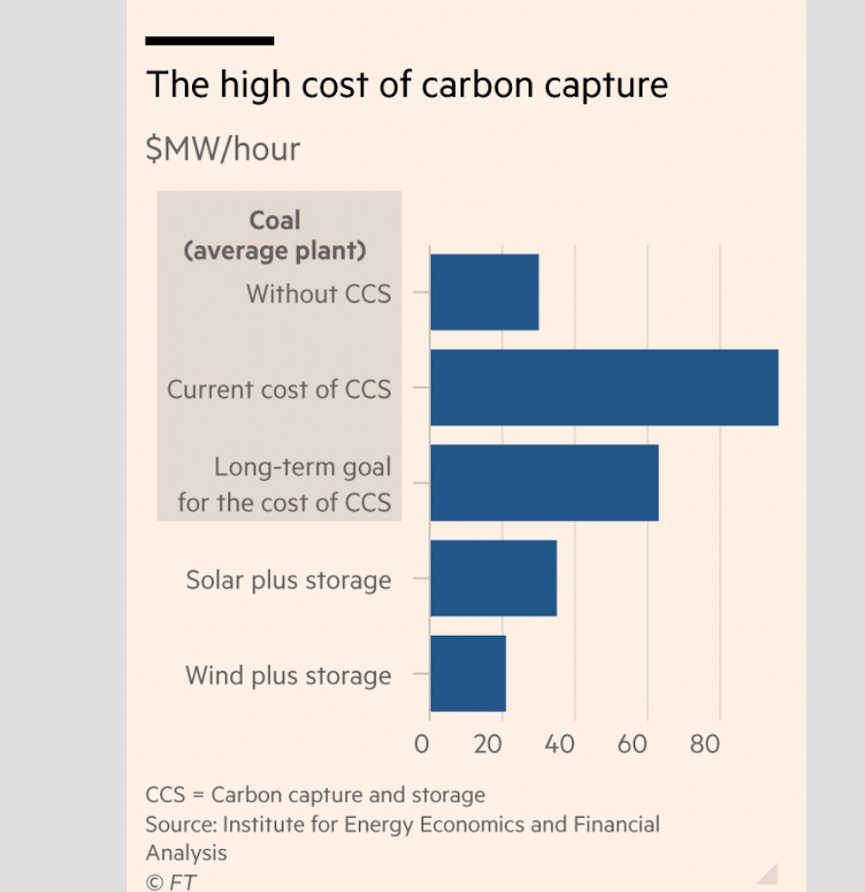
©JSH 2020

Slide 12
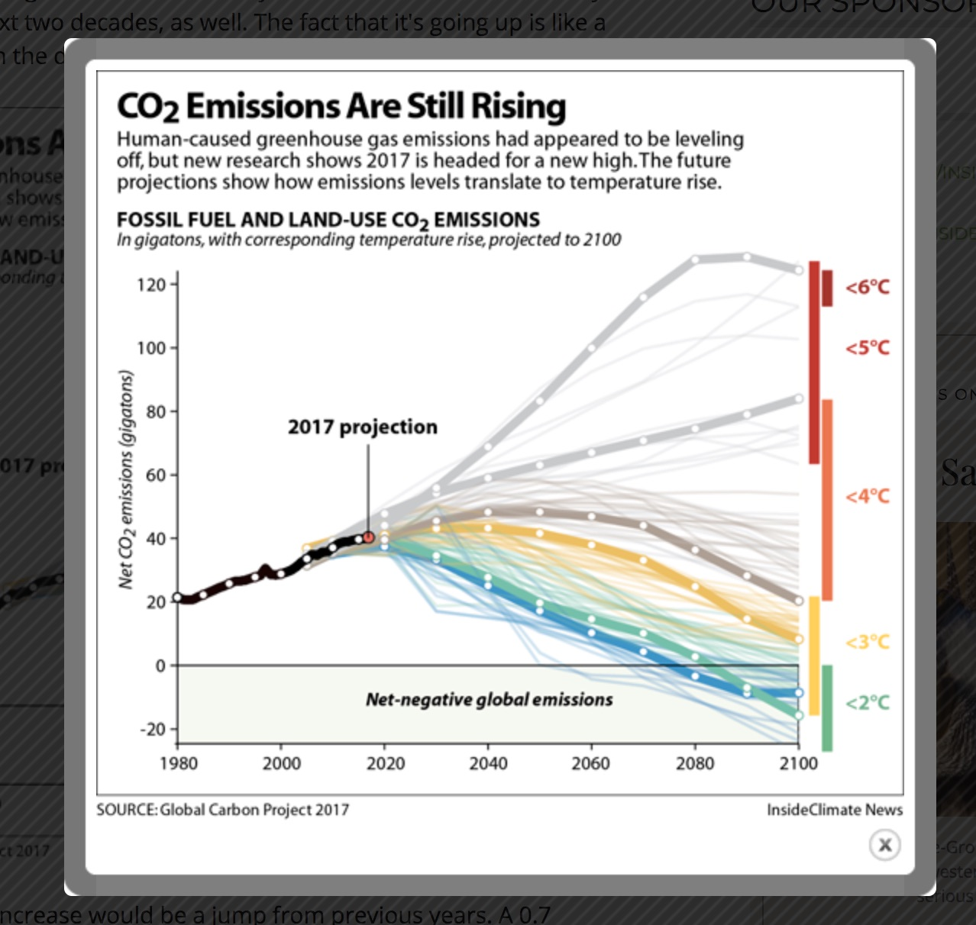
But overall, this approach has failed…

Slide 13
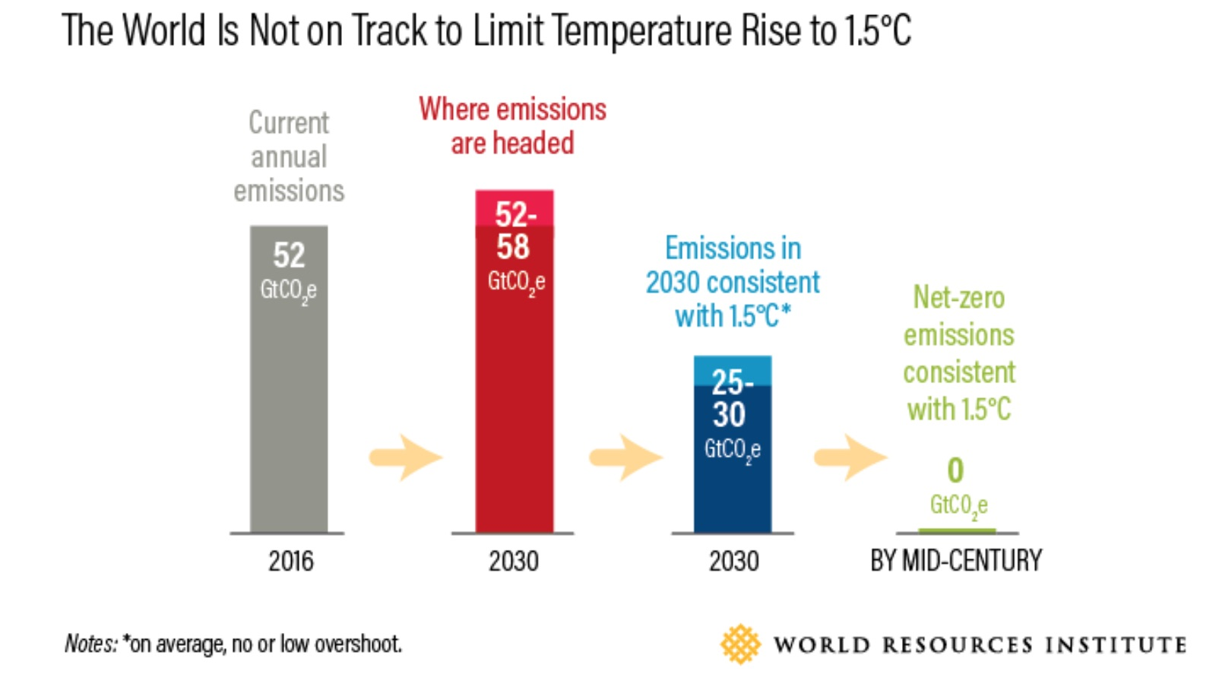
© JSH 2020

Slide 14
…Very latest studies: We are out of time….
12/2015: Paris Climate Accord (COP21): “+1.5 ⁰ C. to “well below 2.0 ⁰ C. by 2100” ave global temp rise (vs. 1855-1900 ave) is still achievable.”
Four years later:
10/2018 IPCC: Debra Roberts, Chair, IPCC: “The next few years are the most important in our history.”
2006-15 global average temp rise is already +.86 ⁰ C. (vs.1850-1900 “pre-industrial” average)…..continuing to rise at .1 to .3 ⁰ C per decade or faster..
At current increase, likely to reach at least + 1.5⁰ C by 2050, +3-5 C by 2100.
Limiting global warming to + 1.5⁰ C. (vs. 2⁰ C.) is needed to avoid devastating impacts.
Without a 50% cut in emissions by 2030 +global ‘net zero” GHG by 2050, we’ll get +3⁰ C- 5 ⁰ C by 2100
5/2019 IBPES: “The sixth extinction is already underway…+ 2.0 ⁰ C. means we lose all coral reefs +5% of species…biodiversity is at risk from climate change and land use..”
6/2019 WIMS: ‘Fish decline 5-17% by 2100, 5% more for each +1.0 ⁰ C”
8/2019 IPCC: 25% of GHG is from deforestation/ agriculture. Only 1/5th of farming is for humans…the rest is to feed livestock (!). And 25% of human food is wasted. + 1.5⁰ C is baked in.
8/2019 McKibbon (350.org): “After 3 decades of soaring emissions, meeting even the modest targets of the Paris Accord has become nearly impossible”
8/2019 Mann: “IPCC may have overestimated the carbon budget by 40%.”
8/2019 Hawkins: (Aspen Institute): “Even if we stop using all fossil fuels today, + 1.5⁰ C is happening..”
2/2020 JPMorgan economists: “Net CO2 needs to be 0 by 2050. This requires a CO2 tax. This will not happen.”
©JSH 2020

Slide 15
Climate Change -- Out of Time
12/2015: Paris Climate Accord (COP21): “+1.5 ⁰ C. to “well below 2.0 ⁰ C. by 2100” ave global temp rise (vs. 1855-1900 ave) is still achievable.”
Four years later:
10/2018 IPCC: Debra Roberts, Chair, IPCC: “The next few years are the most important in our history.”
2006-15 global average temp rise is already +.86 ⁰ C. (vs.1850-1900 “pre-industrial” average)…..continuing to rise at .1 to .3 ⁰ C per decade or faster..
At current increase, likely to reach at least + 1.5⁰ C by 2050, +3-5 C by 2100.
Limiting global warming to + 1.5⁰ C. (vs. 2⁰ C.) is needed to avoid devastating impacts.
Without a 50% cut in emissions by 2030 +global ‘net zero” GHG by 2050, we’ll get +3⁰ C- 5 ⁰ C by 2100
5/2019 IBPES: “The sixth extinction is already underway…+ 2.0 ⁰ C. means we lose all coral reefs +5% of species…biodiversity is at risk from climate change and land use..”
6/2019 WIMS: ‘Fish decline 5-17% by 2100, 5% more for each +1.0 ⁰ C”
8/2019 IPCC: 25% of GHG is from deforestation/ agriculture. Only 1/5th of farming is for humans…the rest is to feed livestock (!). And 25% of human food is wasted. + 1.5⁰ C is baked in.
8/2019 McKibbon (350.org): “After 3 decades of soaring emissions, meeting even the modest targets of the Paris Accord has become nearly impossible”
8/2019 Mann: “IPCC may have overestimated the carbon budget by 40%.”
8/2019 Hawkins: (Aspen Institute): “Even if we stop using all fossil fuels today, + 1.5⁰ C is happening..”
2/2020 JPMorgan economists: “Net CO2 needs to be 0 by 2050. This requires a CO2 tax. This will not happen.”
©JSH 2020

Slide 16
This is showing up all over
© JSH 2020

Slide 17
Key polluters aren’t cooperating…
US has withdrawn from the 2015 COP21 UN Climate Summit accords..
China plans to build +125 new domestic coal-fired power plants
China plans to build +300 new coal-fired power plants abroad (in Turkey, Vietnam, Indonesia, Philippines, Egypt, Bangladesh)
Comparison: US closed 175 coal-fired power plants, 2011-27
Recent estimates: 3.6% to 7% of methane produced by US fracking leaks from pipelines…30X as potent as CO2…enough to more than offset swap of NG for coal in US power generation
Fool’s bargains:
US leaders welcomed fracking expansion as a way to reconcile GHG reduction with
cheap power/ fracking (owned by the oil industry)
-- Irony: Fracking industry as a whole has yet to turn a profit…heavily subsidized
-- Chinese coal plants are similarly heavily subsidized, unprofitable…
©JSH 202-

Slide 18
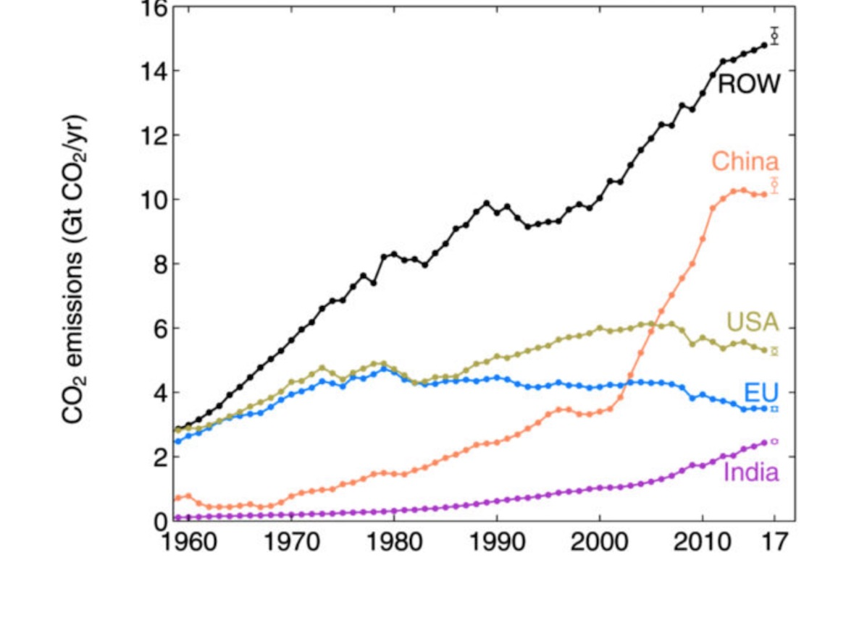
“Global carbon emissions rise 2%/yr in 2017-19 driven by China, India, US…”
China C02 emissions:
+3.5% (+.7% to +5.4%)
2016 - 19
©JSH 2020

Slide 19
“China is cutting coal and CO2 much sooner and faster than official targets suggest..”
— Lauri Myllyvirta, Greenpeace analyst
May 31, 2016
We can’t
predict
China’s
GHG output
accurately
http://www.climatechangenews.com/2016/05/31/china-set-to-blitz-2020-climate-goal-as-emissions-flatline/
“CO2 per unit of GDP by 2020 could “far surpass” the current goal of 40 to 45 per cent” reduction..China’s market for coal is saturating..”
-- Xie Zhenhua, China’s special rep for climate change, Feb 2016
http://www.scmp.com/news/china/policies-politics/article/1916025/chinas-climate-envoy-bullish-hitting-reduction-goal)
“China is forecasting a significant drop of 1% in CO2 emissions
for 2017.”
-- Greenpeace East Asia, Feb 2017
http://www.greenpeace.org/international/en/press/releases/2017/China-forecasts-fourth-year-of-stable-or-declining-CO2-emissions-as-world-awaits-Trump-climate-action---Greenpeace/
©JSH 2020

Slide 20
Impacts Are No Longer “Elsewhere” (1)
Desertification
+2⁰ =>20-30% of land mass is arid; by 2050, 2x the 1930s Dust Bowl migrations
Droughts
Banglalore (2012) Sao Paulo (20 mm, 2016), Capetown (4 mm, 2018); California (5 yrs, 2012-17; threat to 80% of its water); Po Valley (2017:-20% rainfall).
Mass Extinctions
Half of animal species and most large fin fish already gone; more photos of lions/yr than lions.
Food/famine
-Australia: wheat productivity growth: +30%, 1900-90; since 1990, + 0%
-RU: heat killed 2010-11 grain harvest→ slashed exports to Egypt → Arab Spring;
-US: largest corn producer:+2⁰ cuts yield -18%; +4 ⁰ -50%; +815 mm more malnourished by 2030.
Fires
-2019: Australia, Siberia, Amazon, Attica, Ft McMurray: record files
-2019: 12 US states had largest fires in history 7% more lightning strikes per +1⁰; US fire season +78 days/yr since 2000;
-California: largest fire history; mud slides; 00s of deaths; -102 mm trees; -63 tr gallons of ice; half of all 500-yr-old sugar pines
Floods/Storns Houston (8/17): “Harvey:” 34 tr. gallons; Florene (9/18); Haiti, PR (2018): 2x Katrina, -5k lives, $90b); Calcutta (14 mm: 3x burst days. Expanding flood zones; 200 mm emigrants w/in range of sea rise
Melting Glaciers Kilimanjaro; Mt. Kenya; Iceland (Qaterlait); Chacaltaya (Bolivia);Himalayas: by 2050, no ice caps.

Slide 21
Impacts Are No Longer “Elsewhere” (2)
Heat
-2019-20: Hottest summers ever. Extreme heat events in Bangladesh; Indiap Pakista;, Tokyo, Europe; US; Montreal. No. China: 400 mm at risk
-US: NJ, Rhode Island, + 71/3107 counties (34 mm people) already +2⁰ c >
Cairo (2018): “Noone who has any choice about it goes outside”
Human cognition
At 1000 pts/mm, -21%
Ocean warming/ acidification
- 1mm tons of C02 enter water each hour.- Great Barrier Reef (2016-17): half dead. By 2050, all coral reefs gone;
By 2100, oceans warming willl stop all photosynthesis by phytoplankton (produces 2/3s of O2).
- Deep sea warming 9x 1960s rate.
Fish.
-5-16% ocean biomass loss with 1.5-2 C; 90% of big fish are gone; dead zones at all major rivers; by 2050, more plastic than fish in the ocean.
Refugees
World Bank: by 2050, 143-200mm refugees displaced by climate change (vs. Syria’s 1 mm)
Sea ice/ rise.
-IPCC (2003):”+1/2 meter by 2100” but ignored Greenland+Antartica.
-Alaska coast: gone
-Greenland record melt: +23 ft sea rise if it goes; W. Antarctica +40 ft.; more quakes, tsunamis.
- NYC is only planning for +1 meter.
- 10% of world’s pop lives in cities <10 meters above sea level.

Slide 22
TREE CLIMBING LION
Lake Manyara
Tanzania, 1979
(JSH Photo)
(c) JSH 2020

Slide 23
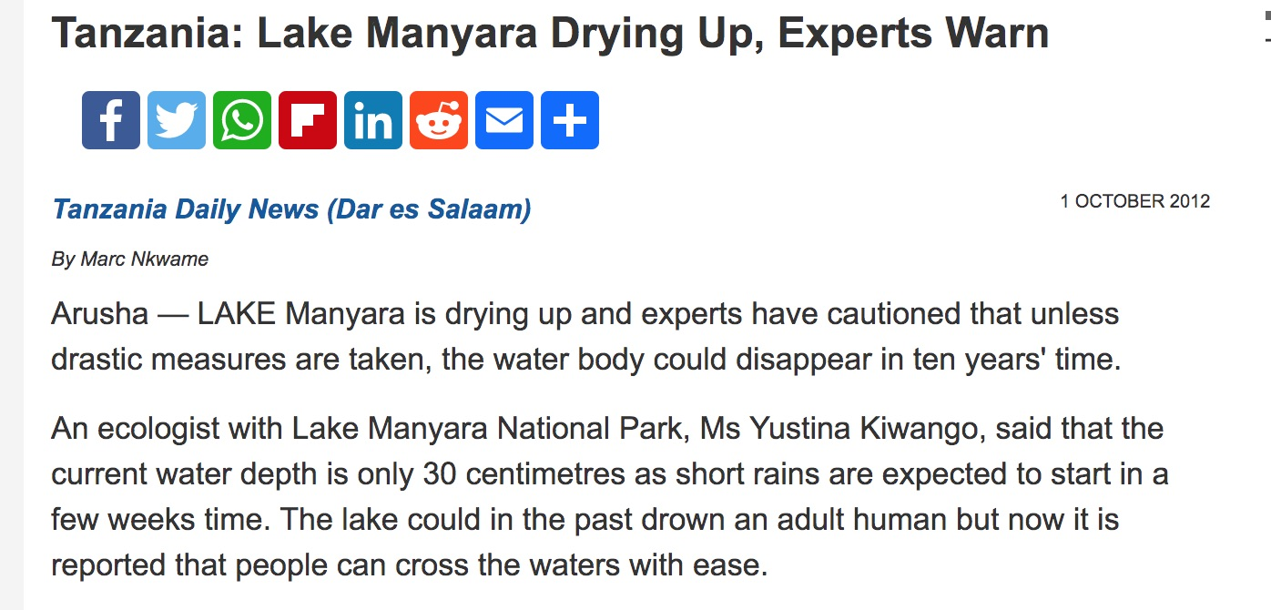
TREE CLIMBING LION
Lake Manyara, 2020:
No Lion, No Tree, and No Lake…
(c) JSH 2020

Slide 24
Mt. Kiliminjaro
1979
(JSH photo)
(c) JSH 2020

Slide 25
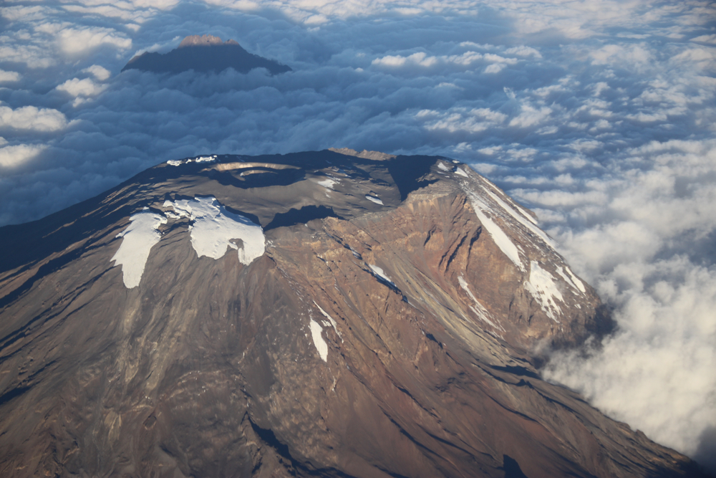
Mt. Kiliminjaro
(2019)
(c) JSH 2020

Slide 26
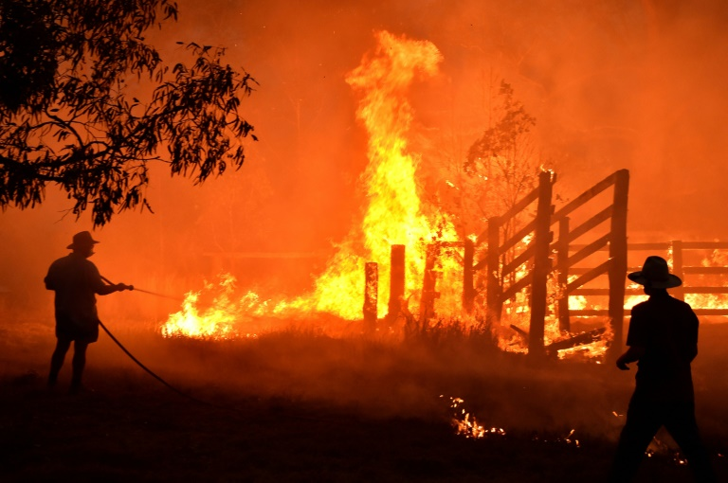
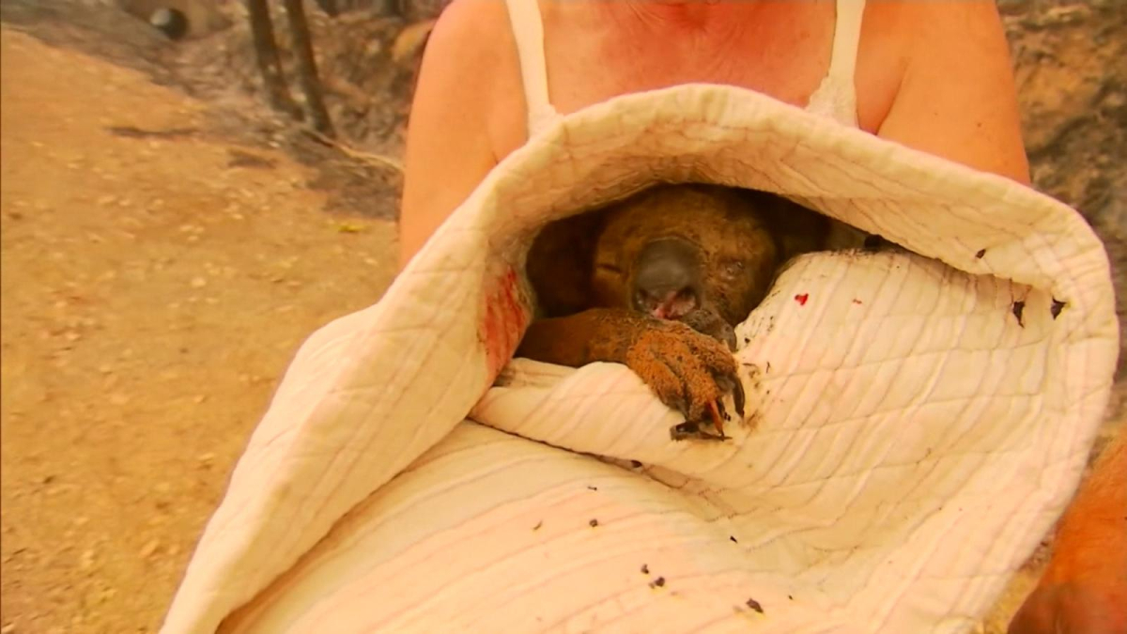
AUSTRALIA
(2019)
(c) JSH 2020
26

Slide 27
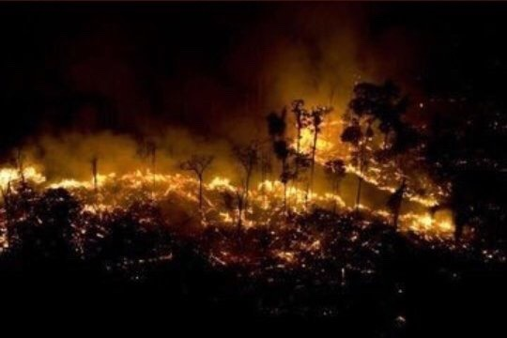
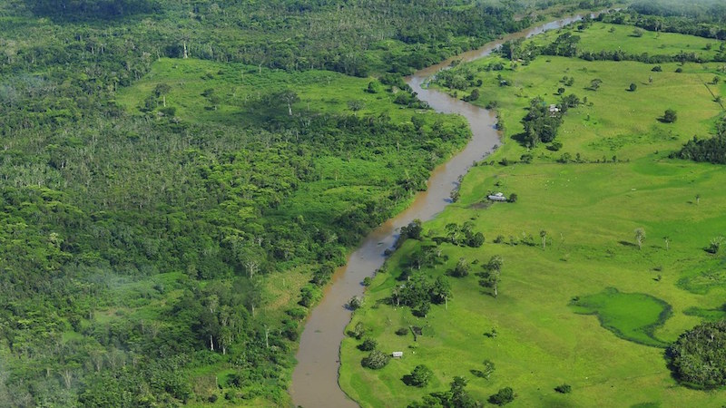
“Bolsonaro shrugs off German aid cuts, as deforestation surges” -- Guardian, 8/12/19
AMAZONAS
(2019)
70k fires, ≈ 80% 1 year increase
(2018-19)
https://www.climatechangenews.com/2019/08/12/bolsonaro-shrugs-off-german-aid-cuts-deforestation-surges/
(c) JSH 2020

Slide 28
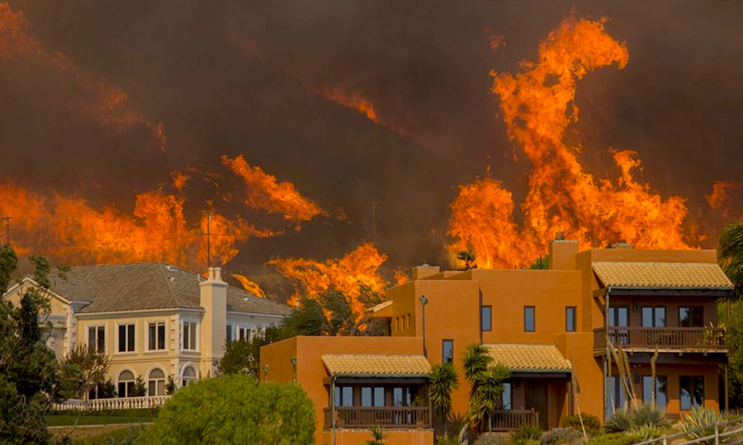
CALIFORNIA
(2019)
(c) JSH 2020
28

Slide 29
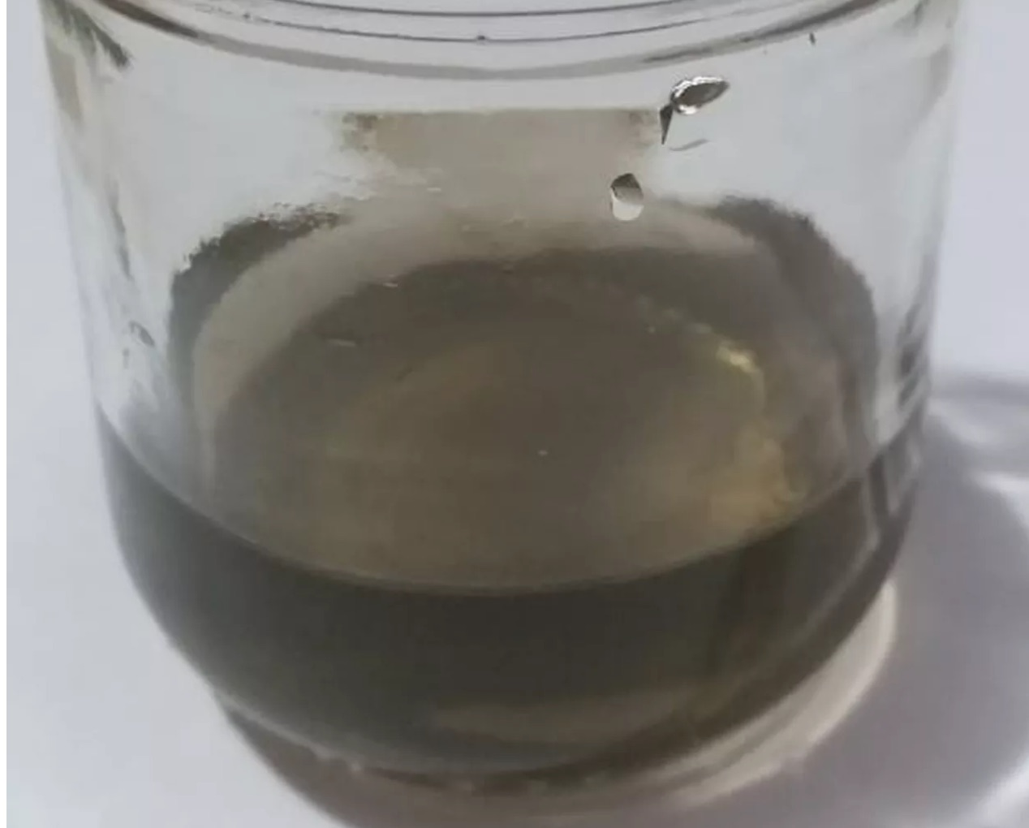
Sao Paulo
(2019)
Black Rain
(c) JSH 2020

Slide 30
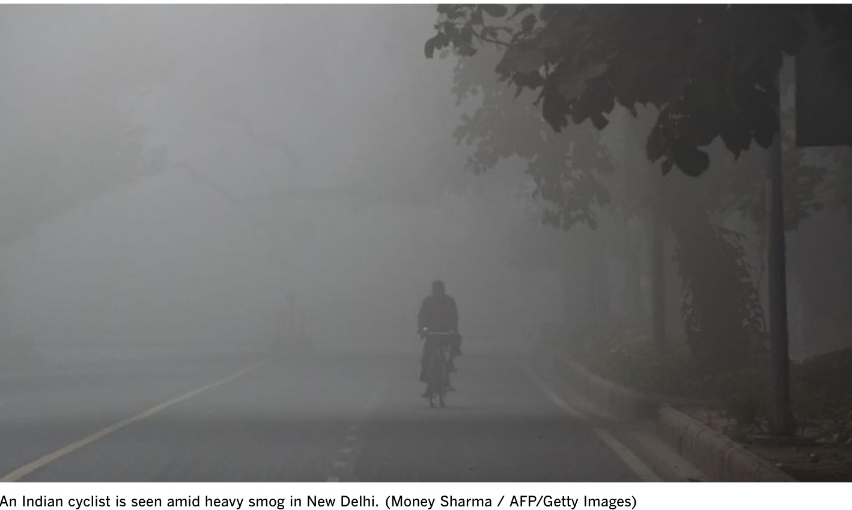
DELHI
(2019)
(c) JSH 2020

Slide 31
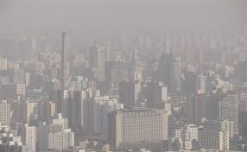
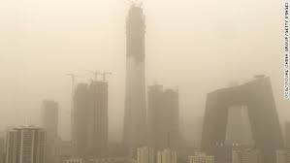
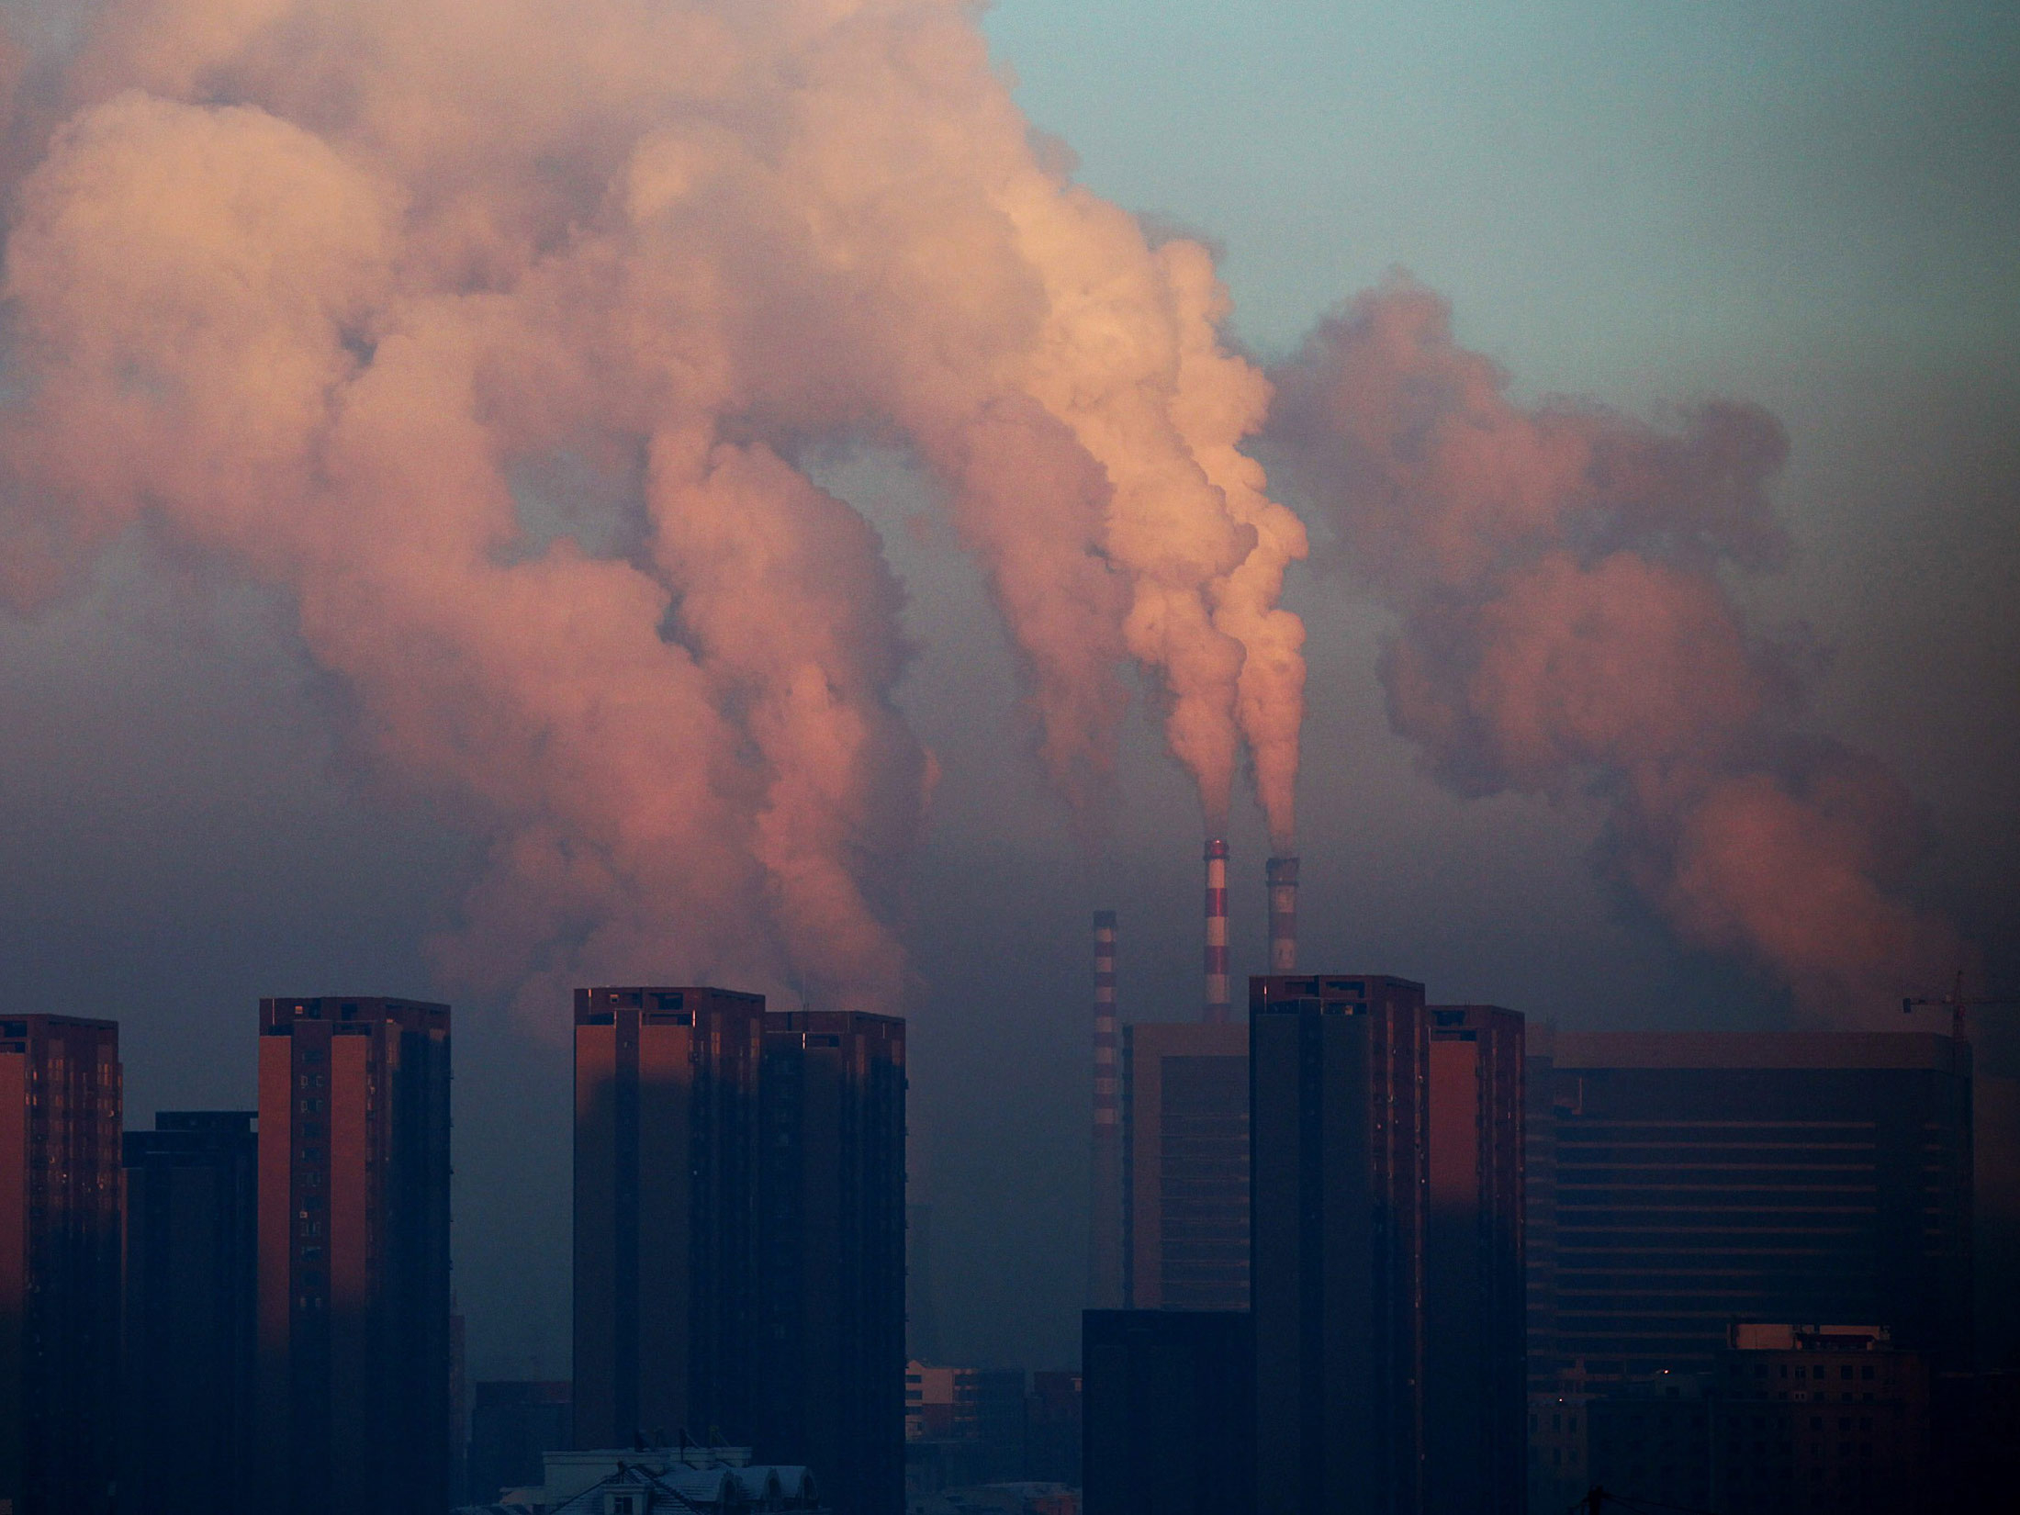
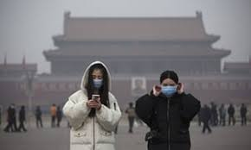
China
(2019)
©JSH 2020

Slide 32
GREENLAND
(2019)
“Lost 217 billion tons
of ice in July 2017..
including 11 b tons on
July 31 2019..”
(c) JSH 2020

Slide 33
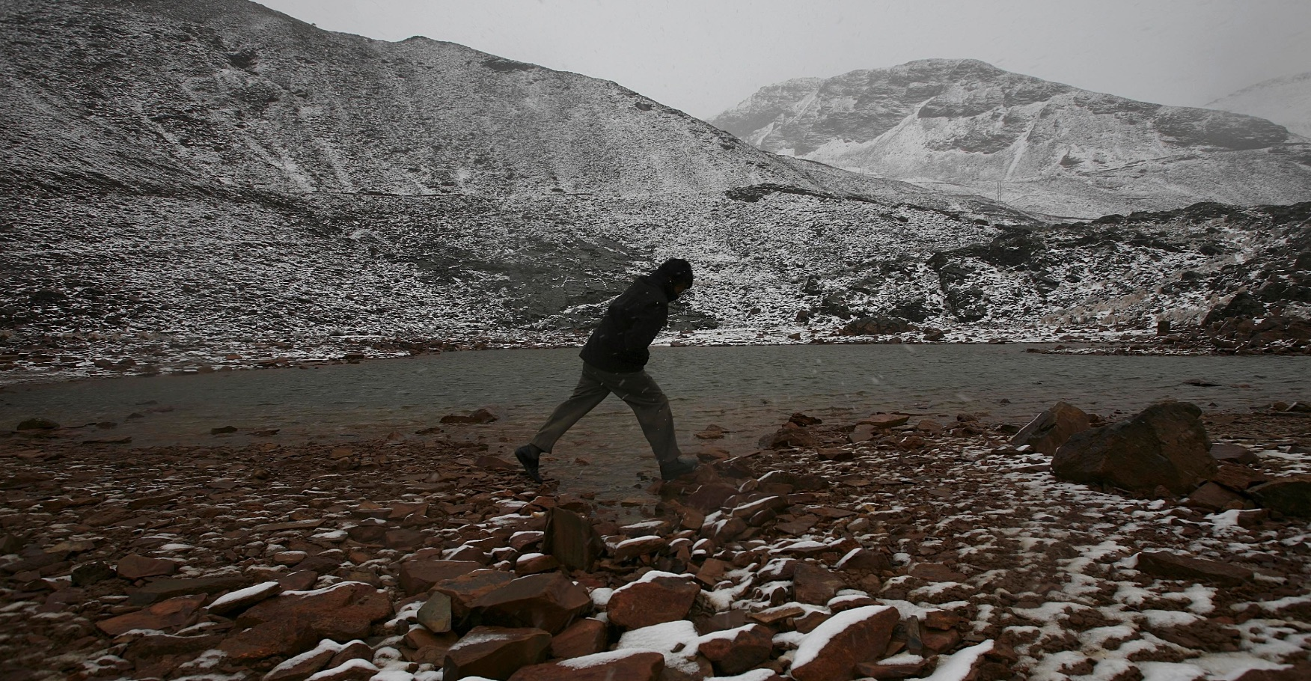
BOLIVIA
Chacaltaya
(2019)
(c) JSH 2020

Slide 34
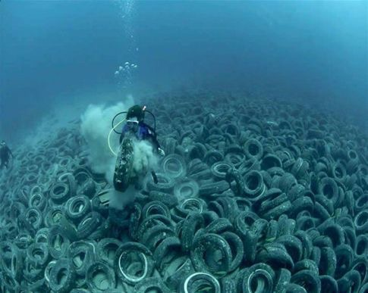
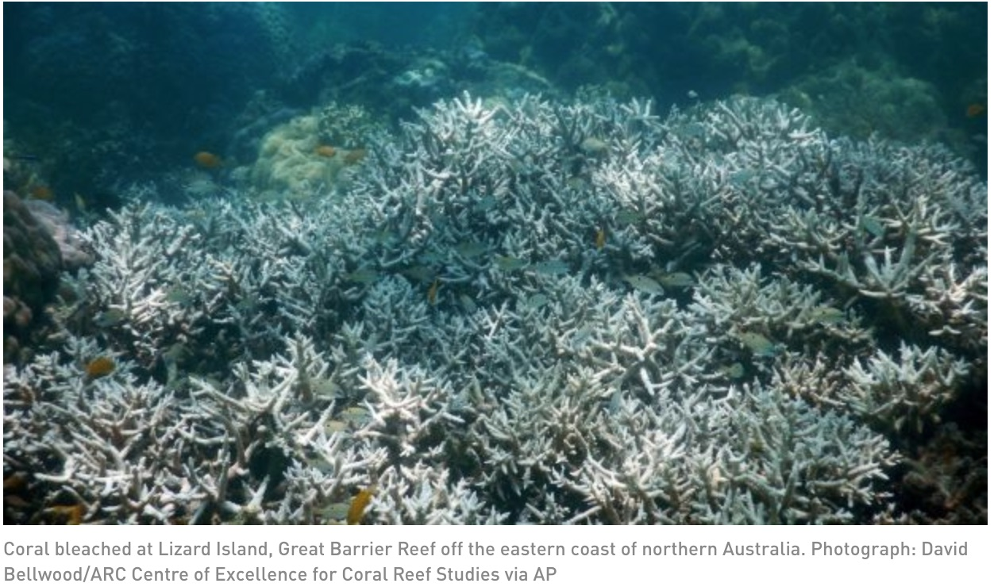
GREAT BARRIER REEF
….Half dead
(2019)
(c) JSH 2020

Slide 35
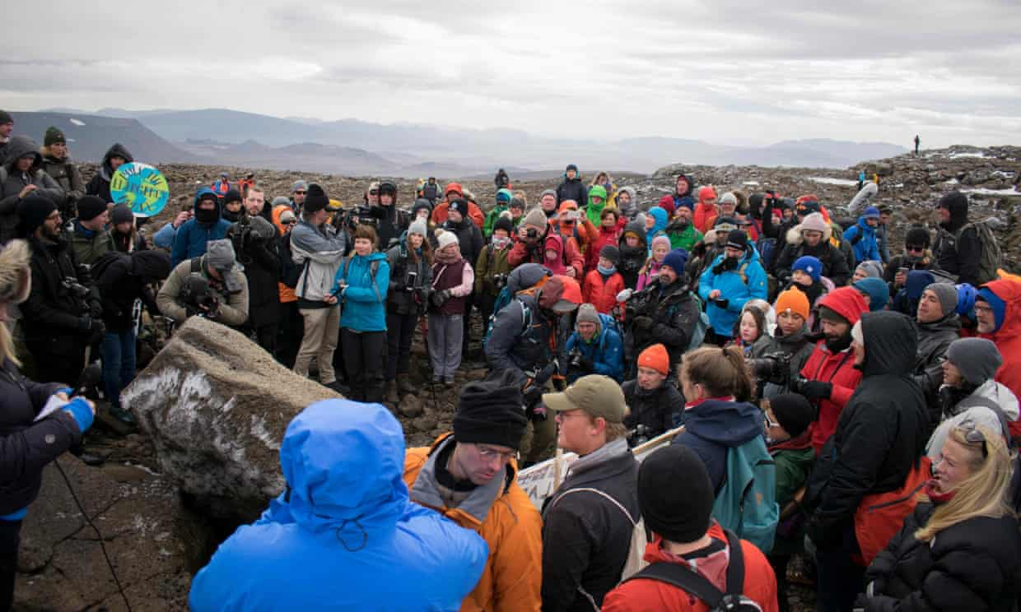
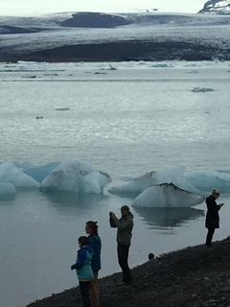
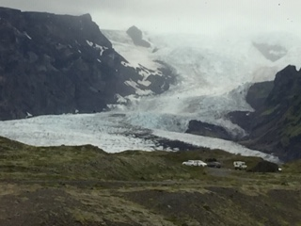
ICELAND
(2019)
(c) JSH 2020

Slide 36
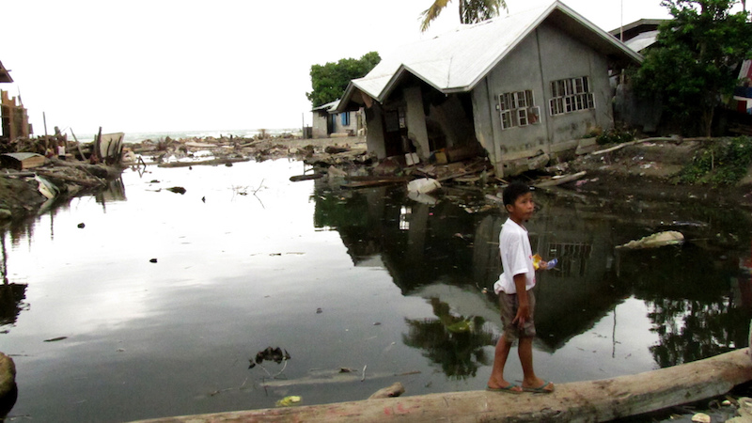
PHILLIPPINES
(2019)
(c) JSH 2020

Slide 37
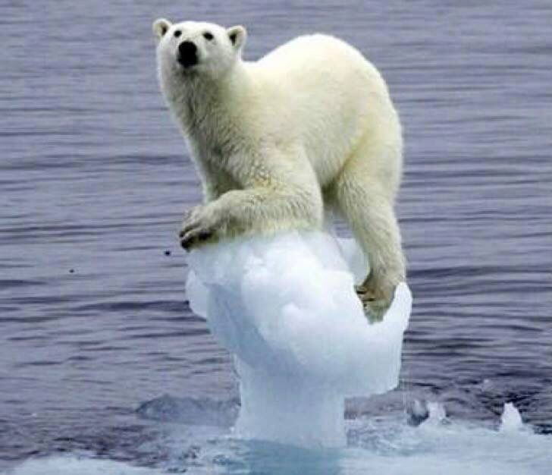
ALASKA
(2020)
…just 25,000 bears left
(c)JSH 2020

Slide 38
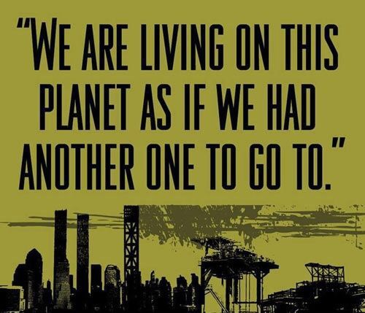
(c)JSH 2020

Slide 39
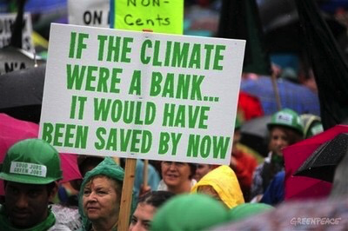
(c)JSH 2020

Slide 40
“We have made changes, yes, sire,
we have made changes,
But we have made them at the right time.
And the right time is,
When there is no other choice.”
-- UK, conservative advisor to
King Edward VII,
1900s
(c) JSH 2020

Slide 41
End Part One
(c) JSH 2020

