Slide 1
Illicit vs illegal The campaign to subvert the SDGs
Alex Cobham
@alexcobham
Tax Justice Network
Nairobi, 5th Pan African Conference on Illicit Financial Flows and Tax 2017
11 October 2017

Slide 2
Overview
Success! Global target to cut illicit financial flows
But: Backlash: Campaign to exempt multinationals?
Illicit vs illegal, and the definition of IFFs
The scale of multinational tax abuse, and the importance of defending the SDG target
Conclusions

Slide 3
UN Sustainable Development Goals: Target 16.4
By 2030, significantly reduce illicit financial and arms flows, strengthen the recovery and return of stolen assets and combat all forms of organized crime
Notes:
Success in three main ways
Substantive:
the first global agreement to fight illicit flows, including – crucially – the major facilitating jurisdictions and financial centres
Narrative shift: a dramatic swing from the MDG view
From: ‘[our] aid drives [your] development’, and ‘[your] corruption undermines [our] effectiveness’;
To: ‘corruption is a global problem undermining [all of our] development; in which major financial centres and multinational companies play a central role’
African leadership:
SDGs more widely owned than donor-driven MDGs;
Within that, target 16.4 is emblematic: driven by Southern countries, with crucial intellectual leadership of High Level Panel on IFF out of Africa

Slide 4
Notes:
Backlash on every point
Substantive:
Attempt to narrow target to illegal activities, measured at level of countries that suffer losses
Narrative shift: attempt to reassert MDG view
Back to: ‘[your] corruption is the real problem’
African leadership: undermined?
Targets for countries to reduce the losses they suffer risk implying accountability of these governments, not those in financial centres or the host countries of multinational companies
Why a backlash?
Global financial crisis => tax justice anger of G20 public, opened door to OECD, G20 alignment with earlier G77 priorities; but now fading?
Tax revenue crisis
Rise of (profile of) inequality
Perceived economic reliance of many OECD and high-income:
Hubs/conduits for financial flows
Host to multinationals
+Multinationals, big four, financial centres etc lobbying?

Slide 5
Definitional questions: two views
Illicit = illegal
“Illicit financial flows (IFFs) are illegal movements of money or capital from one country to another. GFI classifies this movement as an illicit flow when the funds are illegally earned, transferred, and/or utilized.”
Illicit ≠ illegal
Illicit: “forbidden by law, rules or custom” (OED)
Illicit > illegal (e.g. tax); illicit < illegal (e.g. Blankenburg & Khan)
But in all cases, for legal or social reasons, illicit = HIDDEN

Slide 6
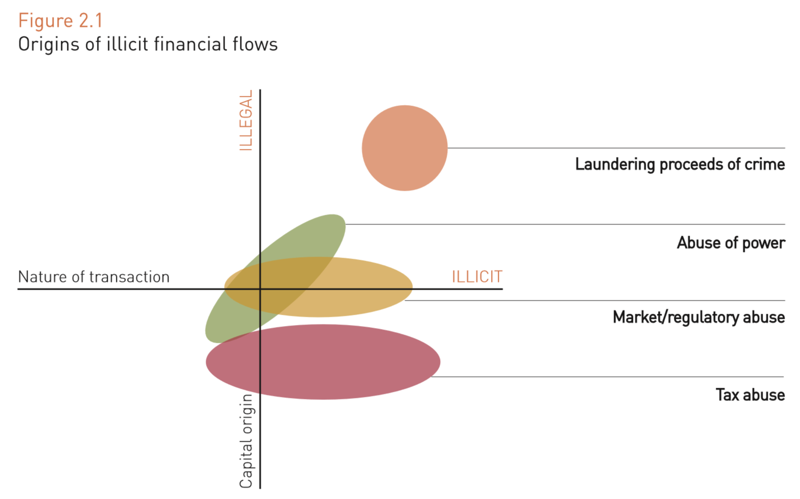
IFF by capital and transaction type
The fight for 16.4: to ensure multinationals’ abuses remain in scope
Old ‘corruption’ view – emphasis here
Notes:
Risk of introducing a systematic bias if insist on strict legality – to the great benefit of multinationals

Slide 7
Leading estimates of IFF
Trade mispricing (GFI, Boyce & Ndikumana, UNECA, Pak…)
Capital account measures (Dooley et al, GFI, Boyce & Ndikumana)
Undeclared wealth (Henry/TJN, Zucman)
Revenue losses: c.$200 billion annually
Shifted profits (TJN, OECD, UNCTAD, IMF)
Revenue losses: c.$500-600 billion annually

Slide 8
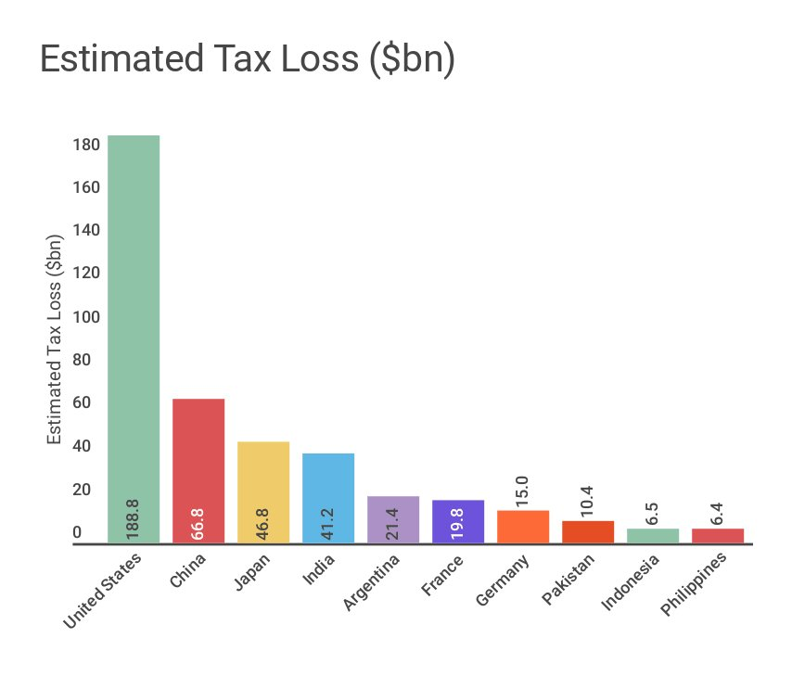
Distribution of impact: tax avoidance

Slide 9
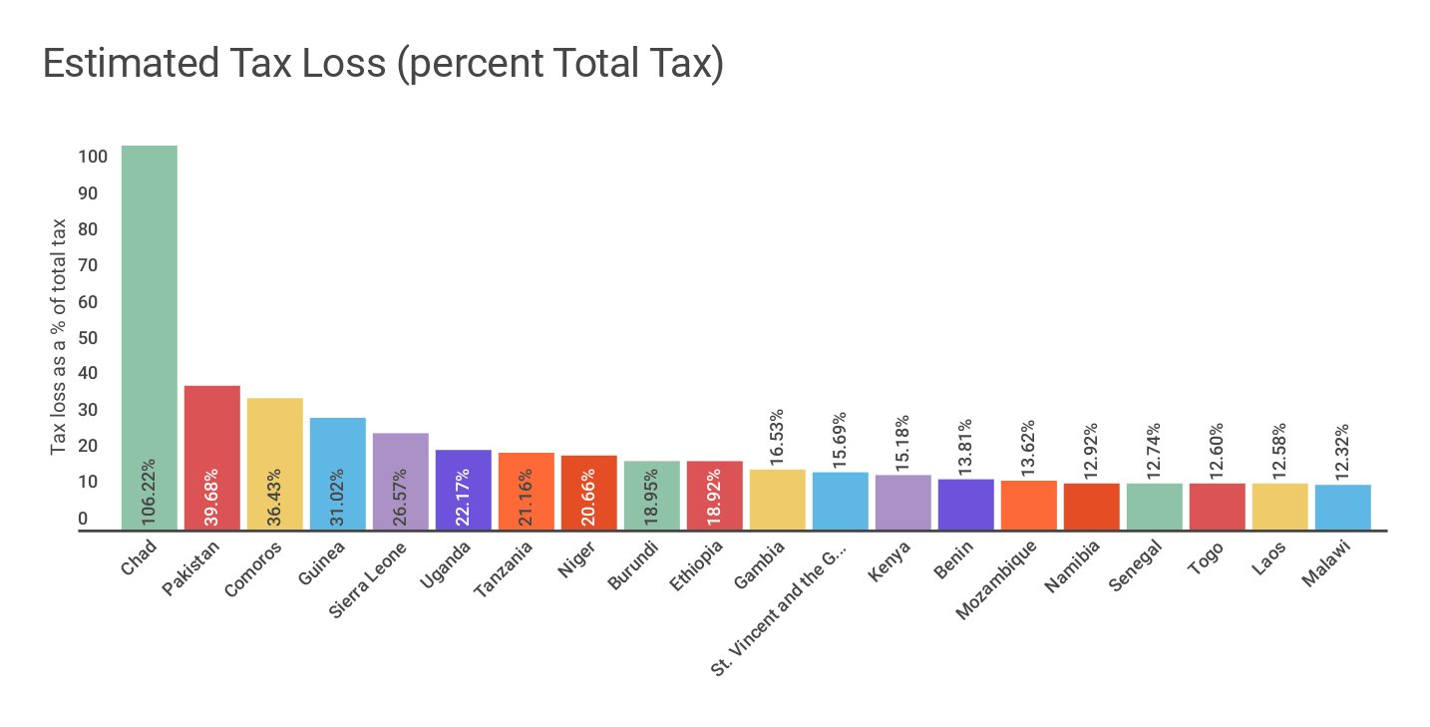
Distribution of impact: tax avoidance

Slide 10
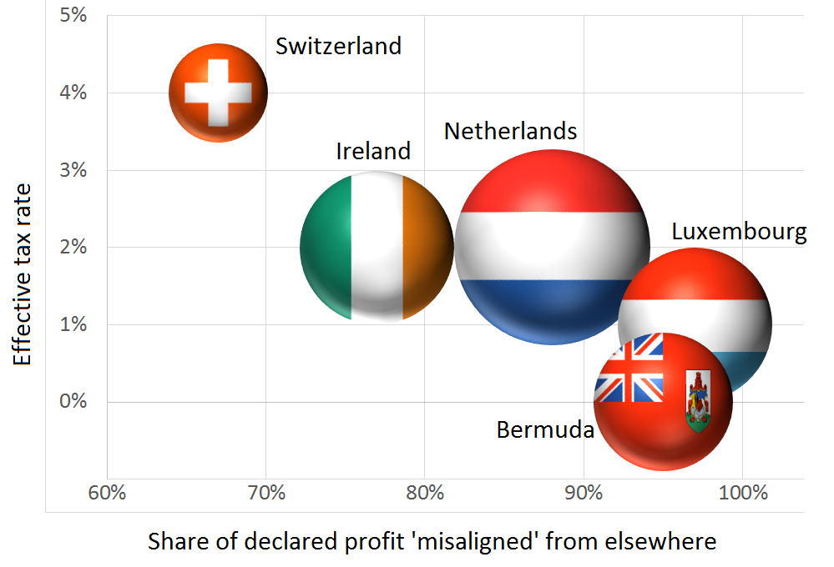
Who wins? (US multinationals)

Slide 11
SDG indicator proposal
There is broad global consensus, from both G77 countries and expressed through the G20/OECD Base Erosion and Profit Shifting (BEPS) process, on a single goal in respect of multinationals’ tax abuses:
to reduce the misalignment between the real economic activity of multinationals, and where their profits are declared for tax purposes.
For SDG 16.4, use multinationals’ country-by-country reporting to track each countries’ misalignment ratio/s (which has more profit than activity?)

Slide 12
Conclusions
Multinational tax abuses disproportionately damage development in lower-income countries.
The illicit vs illegal question has been used in an attempt to subvert the global agreement to fight IFF – and the African leadership behind it – by introducing a systematic bias against tackling multinational tax abuses.
But the measurement of multinationals’ tax abuse is the most robust of all IFF indicators of scale, and country-by-country data will improve this still further. It must remain in the SDGs.

Slide 13
THANK YOU

Slide 14
Illicit vs illegal The campaign to subvert the SDGs
Alex Cobham
@alexcobham
Tax Justice Network
Nairobi, 5th Pan African Conference on Illicit Financial Flows and Tax 2017
11 October 2017

